Slide 1

8th Grade Math: Pre-Algebra
Unit 10, Lesson 8 Exploring Functions Using Equations, Tables, and Graphs Volume 2, pg. 157

Slide 2


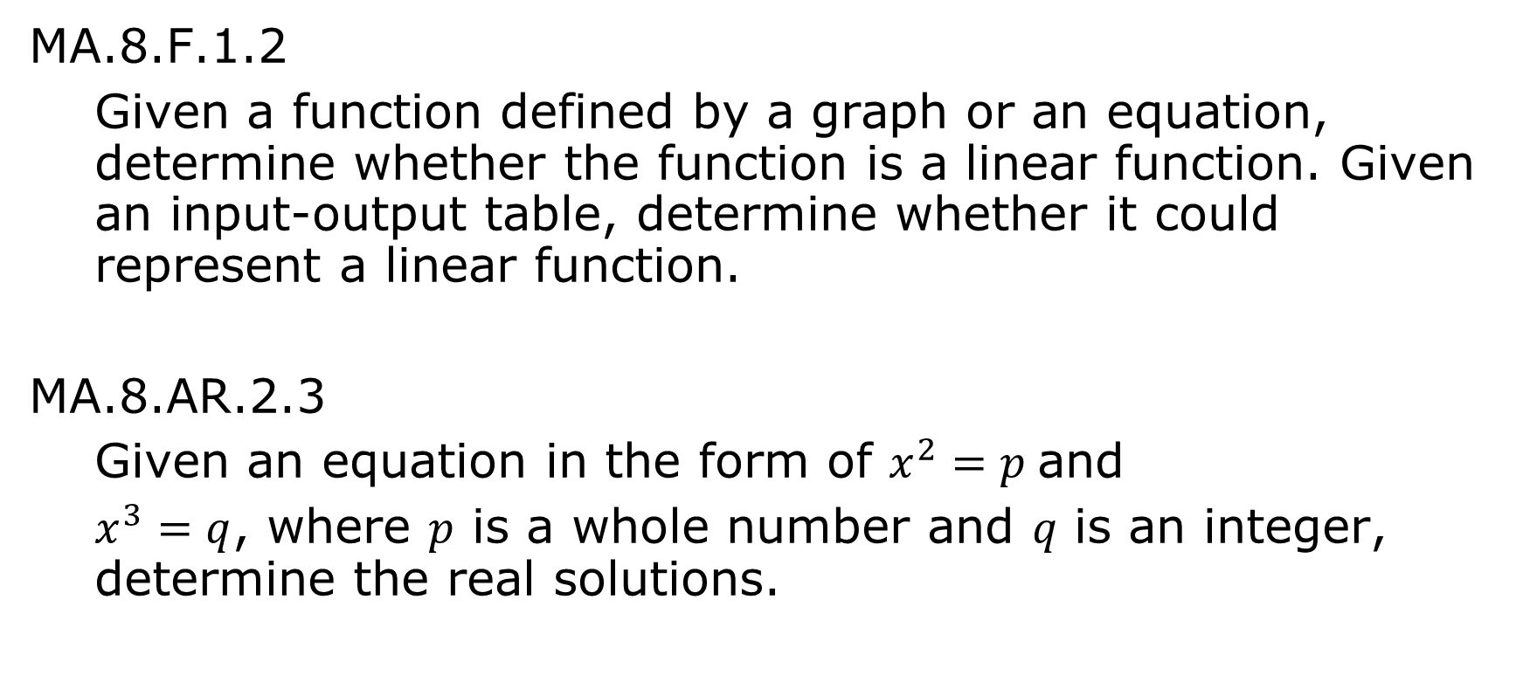
Benchmarks
MA.8.F.1.2
Given a function defined by a graph or an equation, determine whether the function is a linear function. Given an input-output table, determine whether it could represent a linear function.
MA.8.AR.2.3
Given an equation in the form of $x^{2}=p$and
$x^{3}=q$, where $p$ is a whole number and 𝑞 is an integer, determine the real solutions.
volume 2, pg. 157

Slide 3
Integrated Mathematical Thinking and Reasoning Standards
MA.K12.MTR.1.1 Actively participate in effortful learning both individually and collectively.
MA.K12.MTR.2.1 Demonstrate understanding by representing problems in multiple ways.
MA.K12.MTR.4.1 Engage in discussions that reflect on the mathematical thinking of self and others.
MA.K12.MTR.5.1 Use patterns and structure to help understand and connect mathematical concepts.
volume 2, pg. 157

Slide 4

Learning Targets
I can create a table of values from the equation of a function.
I can graph a function using a table of values.
volume 2, pg. 157

Slide 5

Warm-Up
volume 2, pg. 158

Slide 6
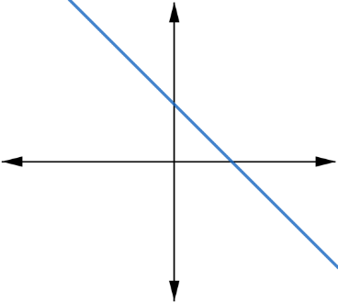
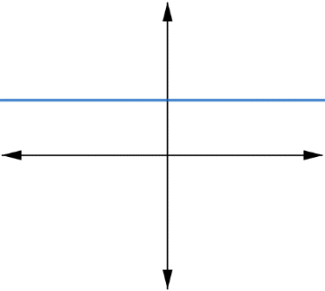
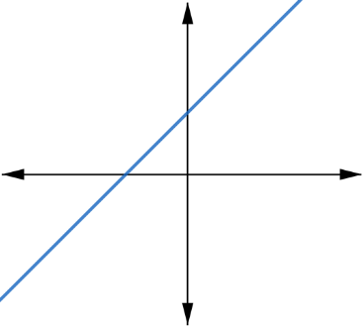
10.8.1 Warm-Up: Bigger and Smaller
Three graphs are shown.
Diego said, “The graphs are ordered from smallest to largest.” Maya disagreed and said, “No. They are ordered from largest to smallest.”
But these are graphs, not numbers!
volume 2, pg. 158

Slide 7
What do you think Diego and Maya are thinking?
volume 2, pg. 158

Slide 8

Collaboration
volume 2, pg. 158

Slide 9

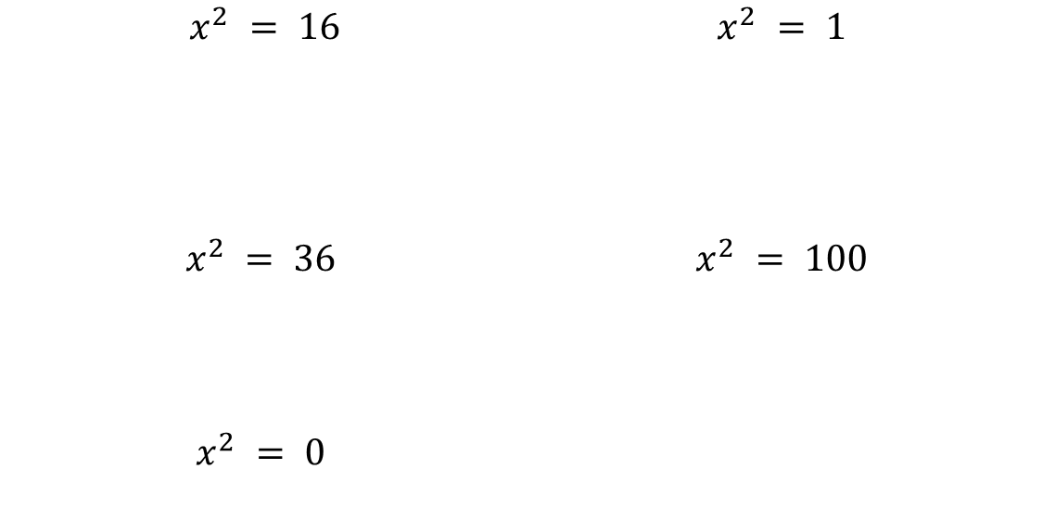
10.8.2 Collaboration: Revisiting Squares and Cubes
Work with your partner on the following.
Solve each equation for 𝑥. Show your work.
$$x^{2} = 16$$ | $$x^{2} = 1$$
$$x^{2} = 36$$ | $$x^{2} = 100$$
$$x^{2} = 0$$
volume 2, pg. 158

Slide 10
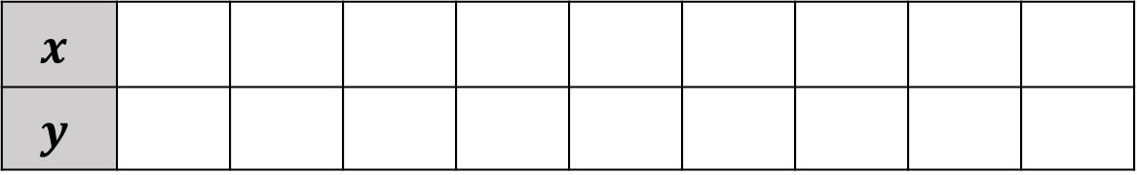
Use your solutions to the previous equations to complete a table of values for the equation $y=x^{2}$.
$$x$$
$$y$$
volume 2, pg. 158

Slide 11
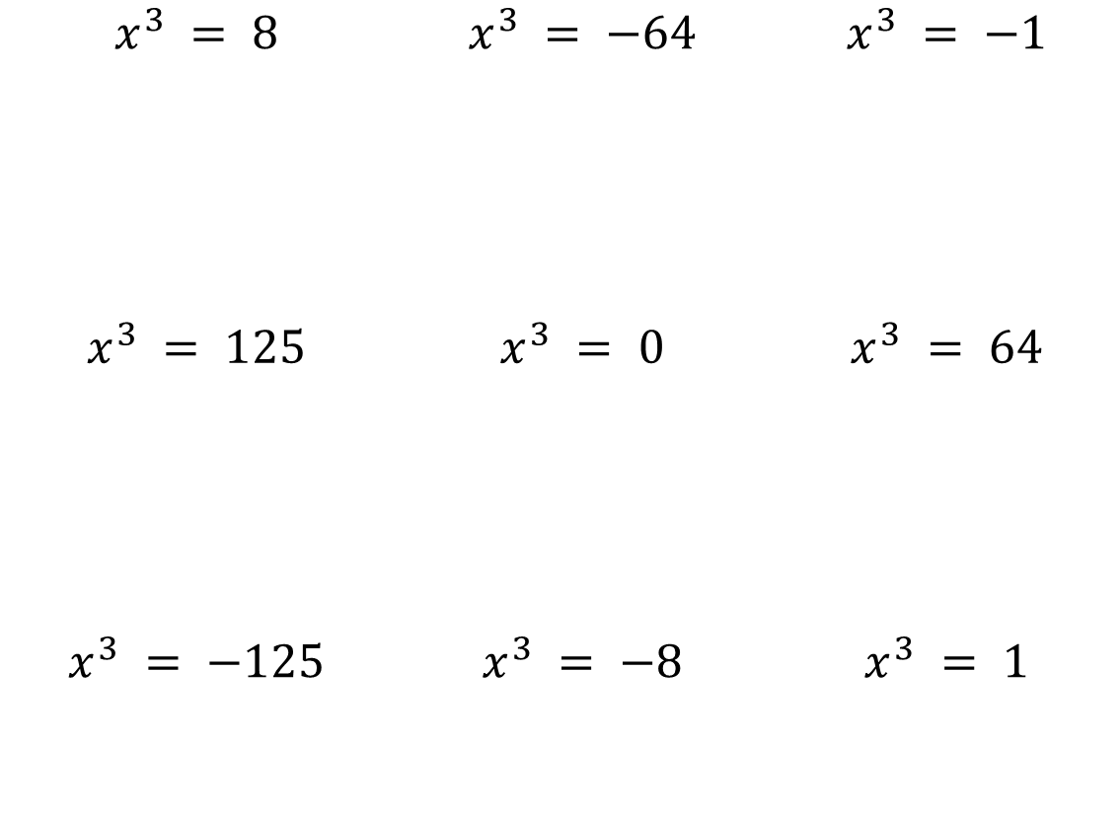
Solve each equation for 𝑥. Show your work.
$$x^{3} = 8$$ | $$x^{3} = −64$$ | $$x^{3} = −1$$
$$x^{3} = 125$$ | $$x^{3} = 0$$ | $$x^{3} = 64$$
$$x^{3} = −125$$ | $$x^{3} = −8$$ | $$x^{3} = 1$$
volume 2, pg. 159

Slide 12
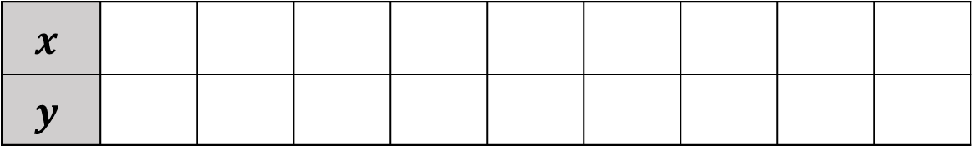
Use your solutions to the previous equations to complete a table of values for the equation $y=x^{3}$.
$$x$$
$$y$$
volume 2, pg. 159

Slide 13
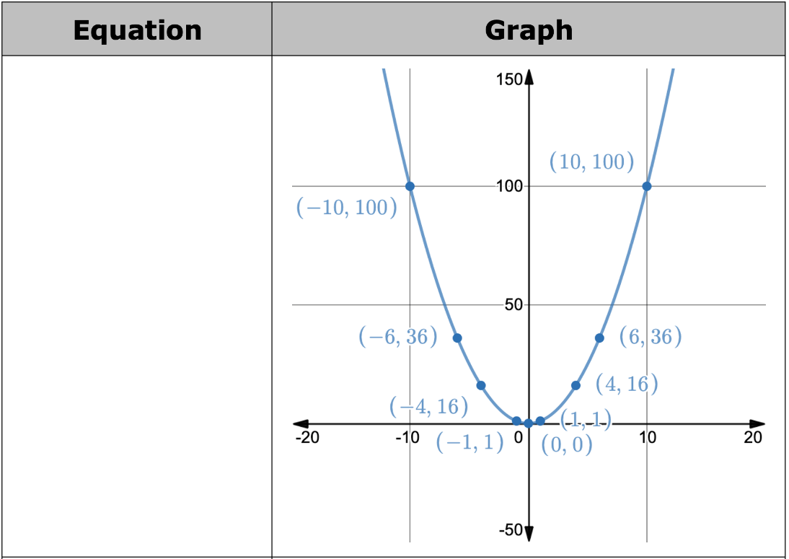
The graphs of both equations are shown. Write the equation that matches each graph based on the tables of values created in the previous problems.
volume 2, pg. 159

Slide 14
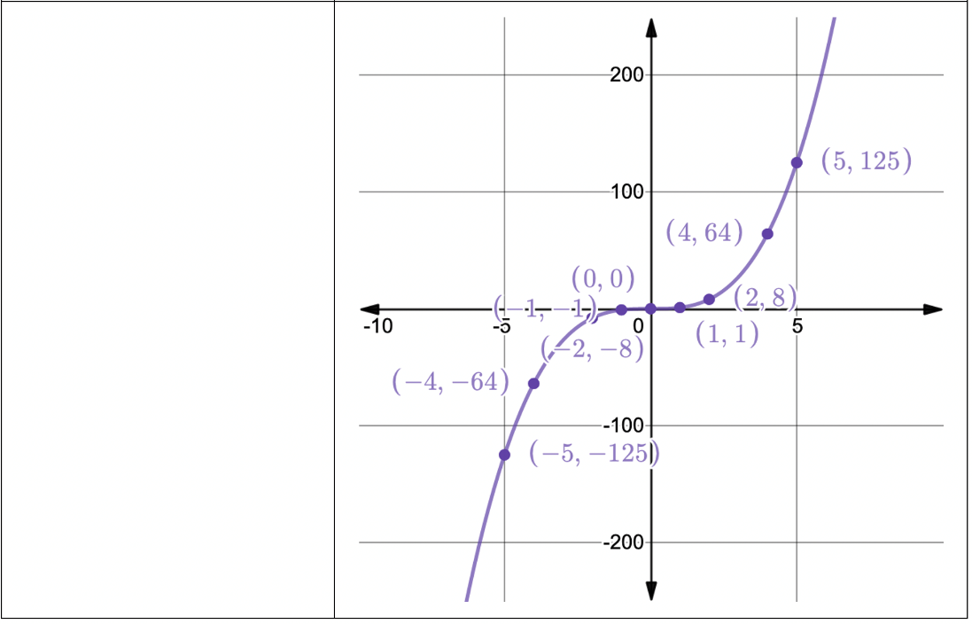
volume 2, pg. 159

Slide 15

Exploration
volume 2, pg. 160

Slide 16

10.8.3 Exploration: Equations and Their Graphs
Relations between two variables can be represented using equations, tables of values, and graphs.
For each of the equations given, work with your partner to create a table of values. Then, plot each ordered pair from the table of values, using them to create a rough sketch of the graph by connecting the points.
One of the graphs and its corresponding table from the collaboration activity have already been included.
volume 2, pg. 160

Slide 17
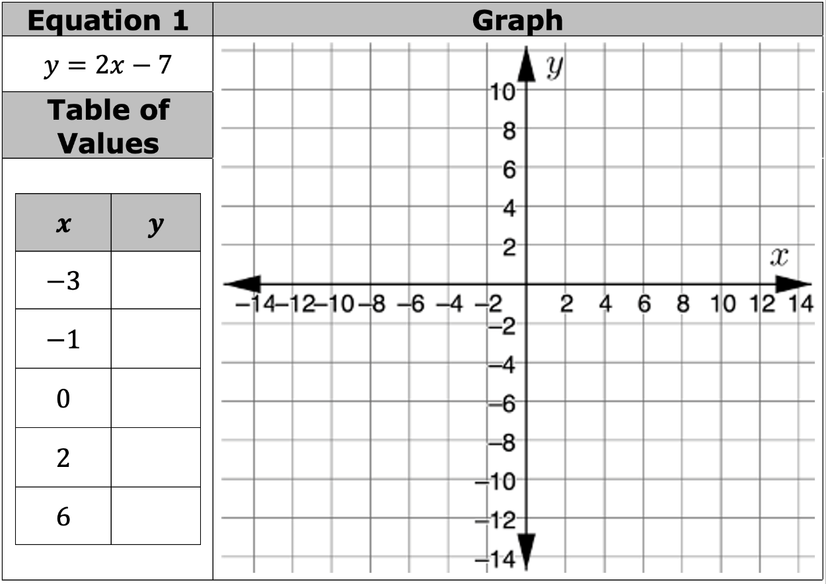
volume 2, pg. 160

Slide 18
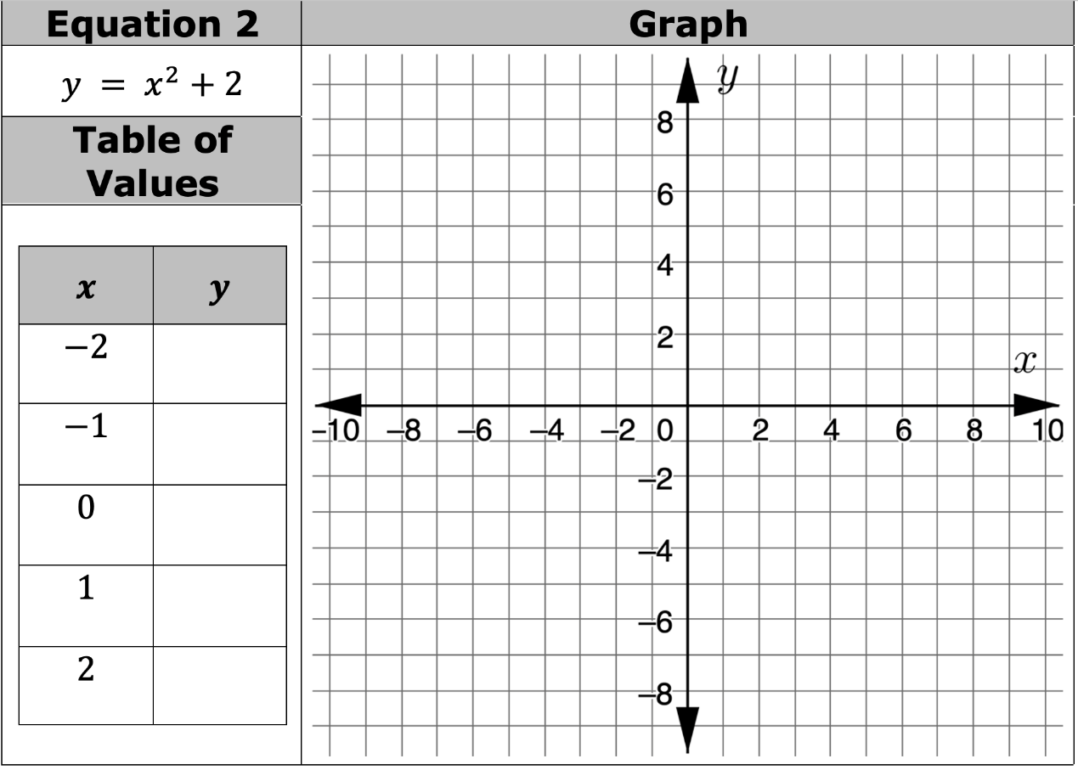
volume 2, pg. 160

Slide 19

volume 2, pg. 160

Slide 20
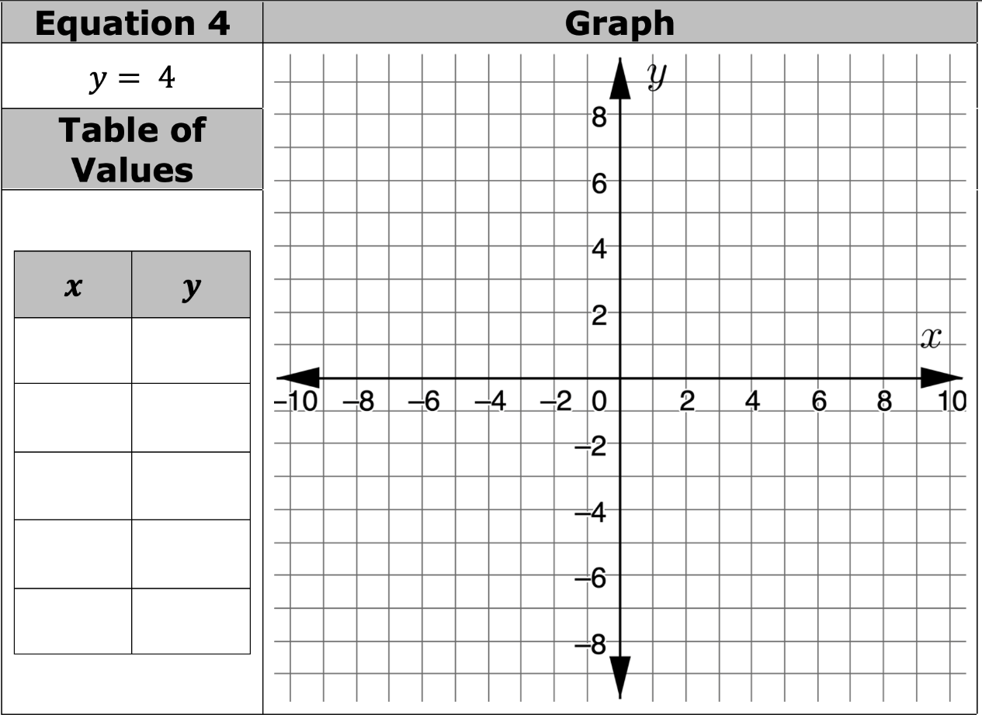
volume 2, pg. 161

Slide 21
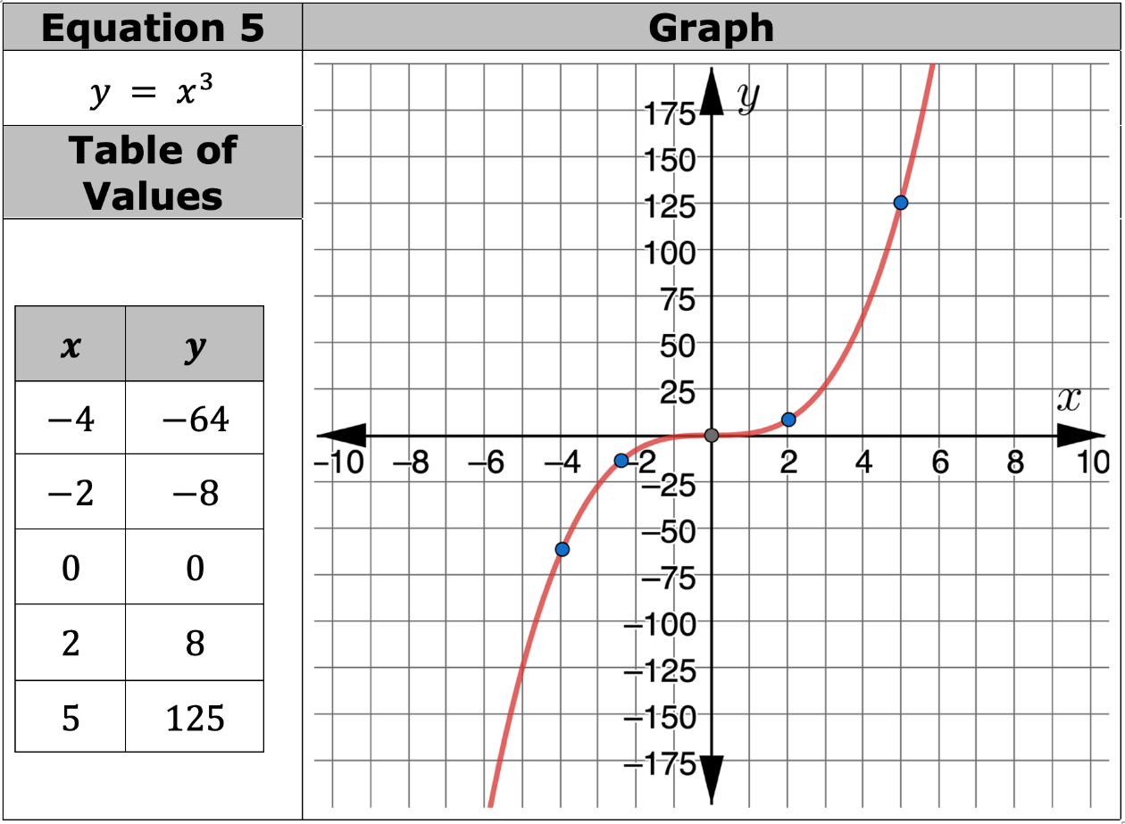
volume 2, pg. 161

Slide 22
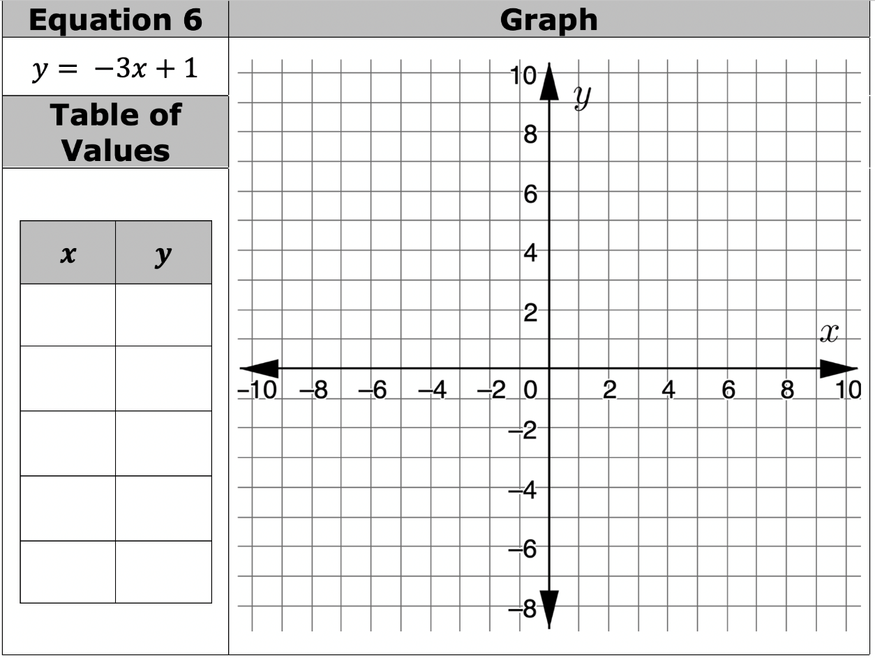
volume 2, pg. 161

Slide 23
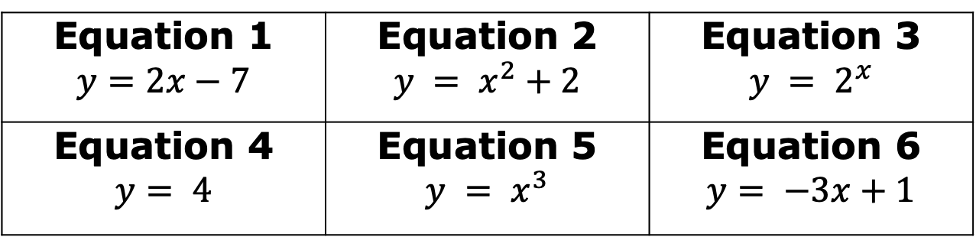
Use the table below to record your answers to Parts A and B based on the exploration.
Equation 1 $y=2x−7$ | Equation 2 $$y = x^{2}+2$$ | Equation 3 $$y = 2^{x}$$
Equation 4 $$y= 4$$ | Equation 5 $$y = x^{3}$$ | Equation 6 $$y= −3x+1$$
Put an asterisk (*) next to each equation that corresponds to a linear graph.
Circle each equation that corresponds to a graph that is NOT linear.
volume 2, pg. 161

Slide 24
Compare the equations that are linear to those that are not linear.
What do the equations that are linear have in common? | What do the equations that are NOT linear have in common?
Make a conjecture about the types of equations that are not linear.
volume 2, pg. 162

Slide 25
Ask two classmates their conjectures. Record their conjectures and write your summary of their reasons.
You are the only person who should write in the first two columns of the table. Have the person initial next to your summary stating that your summary was correct.
Conjectures | My Summary of Their Reasons | Initials
volume 2, pg. 162

Slide 26

Wrap-Up
volume 2, pg. 163

Slide 27
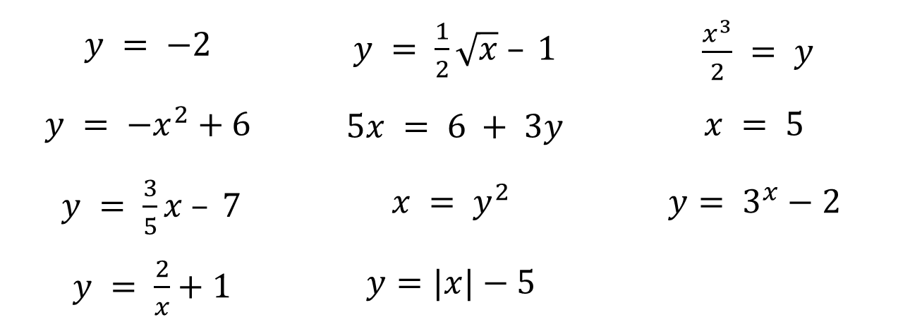
10.8.4 Wrap-Up: Cool Down
Eleven equations are shown. Based on your conjecture about the types of equations that are not linear, circle the equations you predict will produce a graph that is not a line. Use your best judgement. You will have an opportunity to make revisions during the next lesson.
$$y = −2$$ | $y = \frac{1}{2}\sqrt{x} – 1$ | $\frac{x^{3}}{2} = y$
$$y = −x^{2}+6$$ | $5x = 6 + 3y$ | $$x = 5$$
$y = \frac{3}{5}x – 7$ | $$x = y^{2}$$ | $$y= 3^{x}−2$$
$y = \frac{2}{x}+1$ | $$y=|x|−5$$
volume 2, pg. 163

